Slide 1
Natural language understanding at scale with spaCy, Spark NLP and TensorFlow
Claudiu Branzan Alex Thomas David Talby

Slide 2
Natural language understanding at scale with spaCy, Spark NLP and TensorFlow
Please setup your laptop for the tutorial:
1. Install Docker: https://docs.docker.com/engine/installation/
2a. Pull the image: docker pull melcutz/nlu-demo
2b. Or copy the image from the USB drive and run:
docker load -i nlu-demo.docker
3. Run the image:
docker run -it --rm -p 8888:8888 melcutz/nlu-demo
If you don’t want to install the Docker image you can follow along the notebooks at:
https://github.com/melcutz/NLU_tutorial

Slide 3
Natural Language Understanding is an AI-Complete problem.

Slide 4
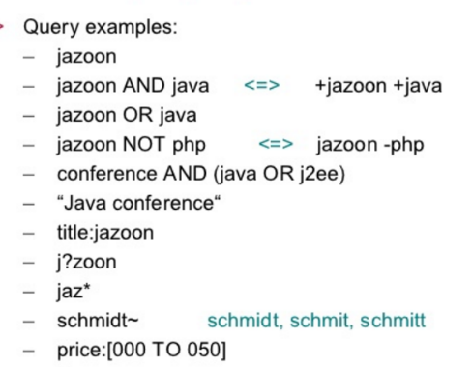
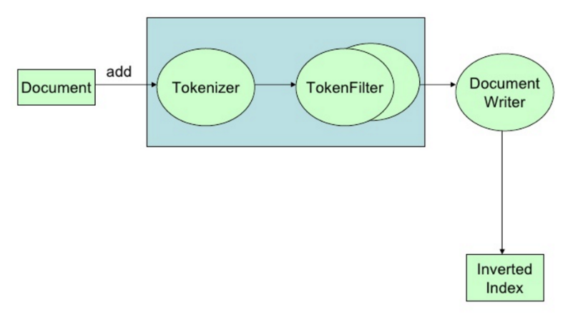
AT THE BEGINNING, THERE WAS SEARCH
Scalable & robust Indexing pipeline
Tokenizers & analyzers
Synonyms, spellers & Auto-suggest
File formats & header boosting
Rankers, link & reputation boosting

Slide 5
THEN, YOU NEED TO UNDERSTAND LANGUAGE
Prescribing sick days due to diagnosis of influenza. | Positive
Jane complains about flu-like symptoms. | Speculative
Jane’s RIDT came back clean. | Negative
Jane is at risk for flu if she’s not vaccinated. | Conditional
Jane’s older brother had the flu last month. | Family history
Jane had a severe case of flu last year. | Patient history
Parts of Speech • Dependency Parsing • Coreference Resolution • Entity Recognition

Slide 6
What makes language hard
Nuanced
Sure / I agree / Absolutely! / Whatever / Yes sir / Just to see you smile ❤️
Fuzzy
Blue, New, Tall, Child, Tell, Do
Contextual
“Patient denies alcohol abuse”
Medium specific
“SGTM c u in 15”
Domain specific
All forward-looking statements included in this document are based on information available to us on the date hereof, and we assume no obligation to revise or publicly release any revision to any such forward-looking statement, except as may otherwise be required by law.

Slide 7
Use cases
 | Get by with rules, search, RegEx, attribute extraction | Welcome to the world of NLP, ML and DL
Social media | Does this social media post contain an offensive word? | Is this social media post offensive?
Legal | Find patents with the terms ‘car’ and battery’, or synonyms | Who is patenting next-gen electrical car batteries?
Support | Find products mentioned in customer emails or phone calls | What is this customer complaining about?
Finance | Extract the fee structure from a mutual fund prospectus | Are UK pensions allowed to invest in this fund?
Healthcare | Extract the patient’s blood pressure reading from a note | Does this patient have high blood pressure?

Slide 8
OUR agenda in 5 notebooks
Introduction to spaCy
Named entity extraction & Word embeddings
ML & NLP: Building a document classifier
Introduction to Spark NLP
Embeddings, topics & model fitting with Spark NLP

Slide 9
NLP libraries
By Ecosystem:
Python: NLTK, SpaCy, gensim
JVM: OpenNLP, CoreNLP, Spark NLP, UIMA, GATE, Mallet
Others: tm for R, SAS, Watson, Matlab, …
By Design:
Raw functionality: NLTK, OpenNLP
Annotation libraries: spaCy, Spark NLP, UIMA, GATE
Industrial Grade, Open Source, Supported:
spaCy
Spark NLP

Slide 10
ML & NLP: Common misconceptions
I can keep my NLP and ML pipelines separate
So, can I just store the NLP output, then iterate with ML?
No. Feature engineering is part of your ML pipeline
An NLP library needs its own model training code
So, should it implement its own ML algorithms?
No. The world doesn’t need another KNN / W2V / CRF
I don’t need to train, because libraries come with models
So, can I just reuse the models that came with my library?
No, in most cases. NLP is medium- & domain-specific

Slide 11
Introducing spark nlp
Industrial Grade NLP for the Spark, Java & Scala ecosystem
Design Goals
Performance & Scale
Frictionless Reuse
Enterprise Grade
Build on top of the Spark 2.0 ML API’s
Apache 2.0 licensed, with active development & support

Slide 12
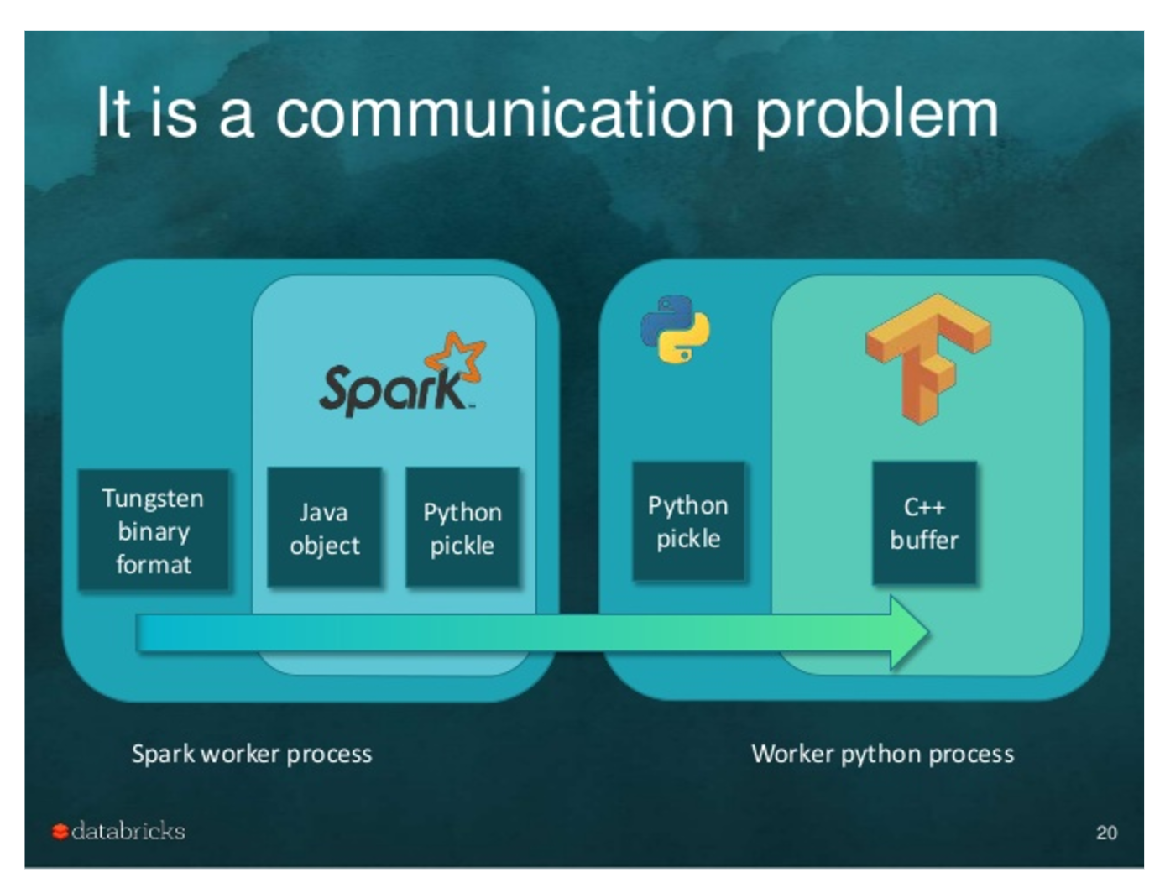
The performance bottleneck
Image Credit: Tim Hunter’s TensorFrames overview

Slide 13
Reuse: out of the box functionality
New in Spark NLP | Reused from Spark ML
Tokenizer Normalizer Stemmer Lemmatizer Entity extractor Date extractor Part of Speech tagger Named entity recognizer Sentence boundary detection Sentiment analysis Spell checker | Topic modeling Word 2 Vec TF-IDF String distance calculation N-grams calculation Stop words removal Classification Regression Ensembles Train/Test & Cross-Validation Grid Search

Slide 14
THANK YOU!
Claudiu Branzan Alex Thomas David Talby

